Slide 1
Maharaja Agrasen Institute of Technology ETCS 211 Computer Graphics & Multimedia UNIT 1
DDA LINE DRAWING ALGORITHMS

Slide 2
Scan Conversion
Output Primitives
Basic geometric structures used to describe scenes.
Can be grouped into more complex structures
Example : Point, straight line segments, circles and other conic sections, polygon color areas and character strings
Construct the vector picture
Rasterization
The process of determining the appropriate pixels for representing picture or graphic object
Scan conversion
It is the final step of rasterization . It converts picture definition into a set of pixel-intensity values for storage in the frame buffer.

Slide 3
Scan Conversion cont..
Scan Converting a Point
A mathematical point (x,y) needs to be scan converted to a pixel at location (x´, y´).
With a CRT monitor, the electron beam is turned on to illuminate the screen phosphor at the selected location.

Slide 4
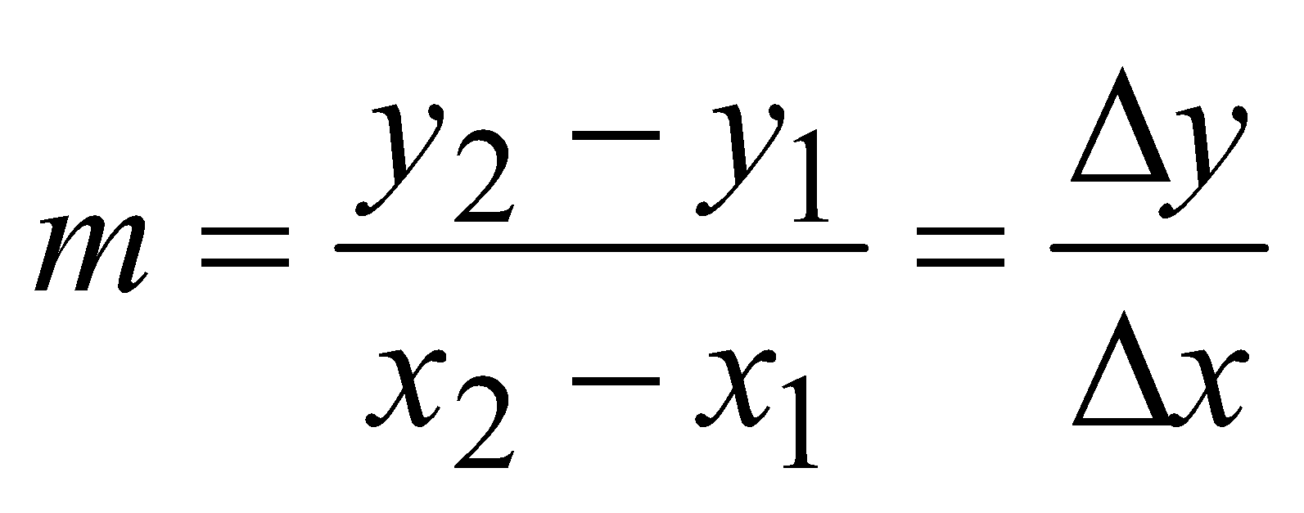
Scan Conversion cont..
Scan Converting a Line
Line drawing is accomplished by calculating intermediate positions along the line path between two specified endpoint positions.
Cartesian equation:
y = mx + c
Where
m – slope
c – y-intercept
y₂
y₁
x₁
x₂

Slide 5
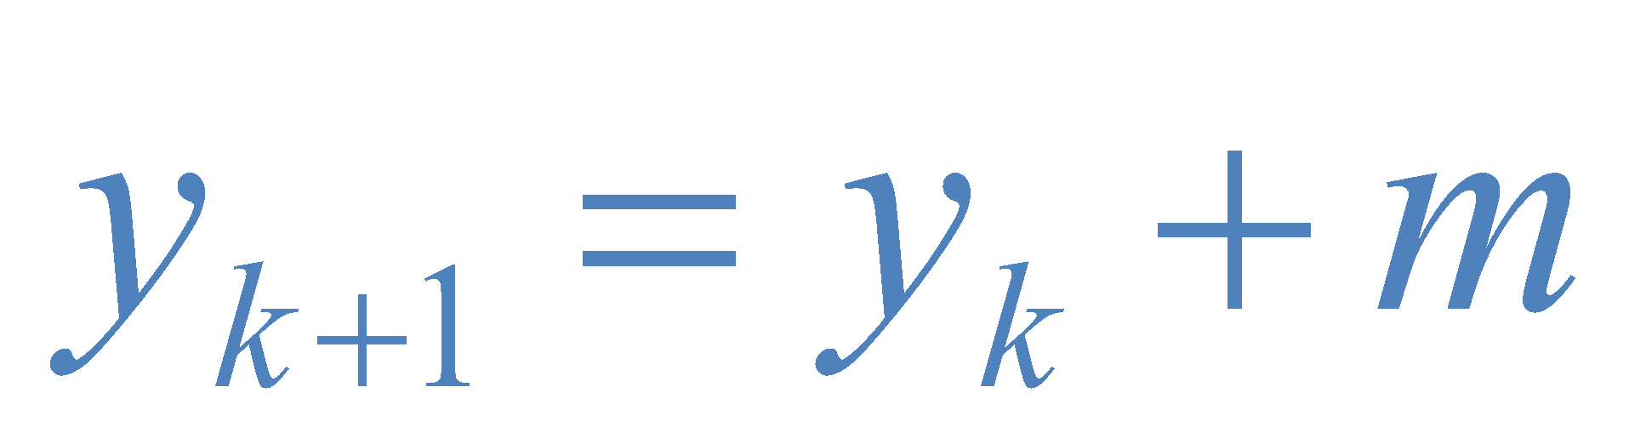
The Digital Differential Analyzer (DDA) Algorithm
Digital Differential Analyzer
0 < Slope <= 1
Unit x interval = 1
y2
y1
x1
x2

Slide 6
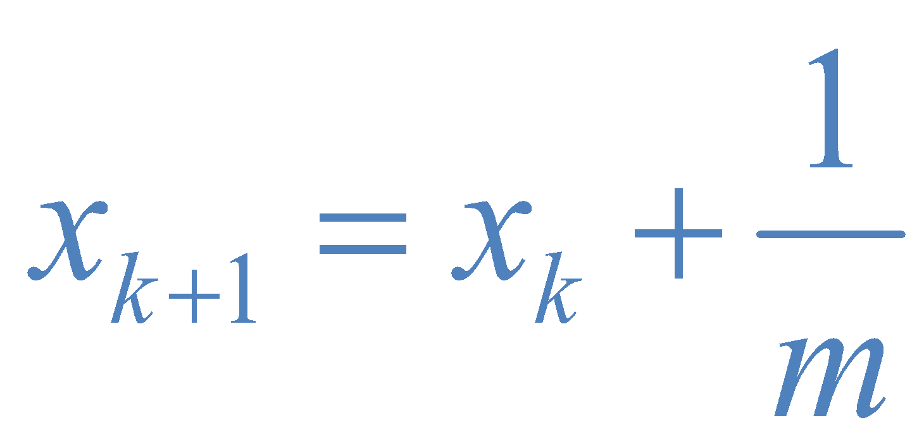
The DDA Algorithm cont..
Digital Differential Analyzer
0 < Slope <= 1
Unit x interval = 1
Slope > 1
Unit y interval = 1
y2
y1
x1
x2

Slide 7
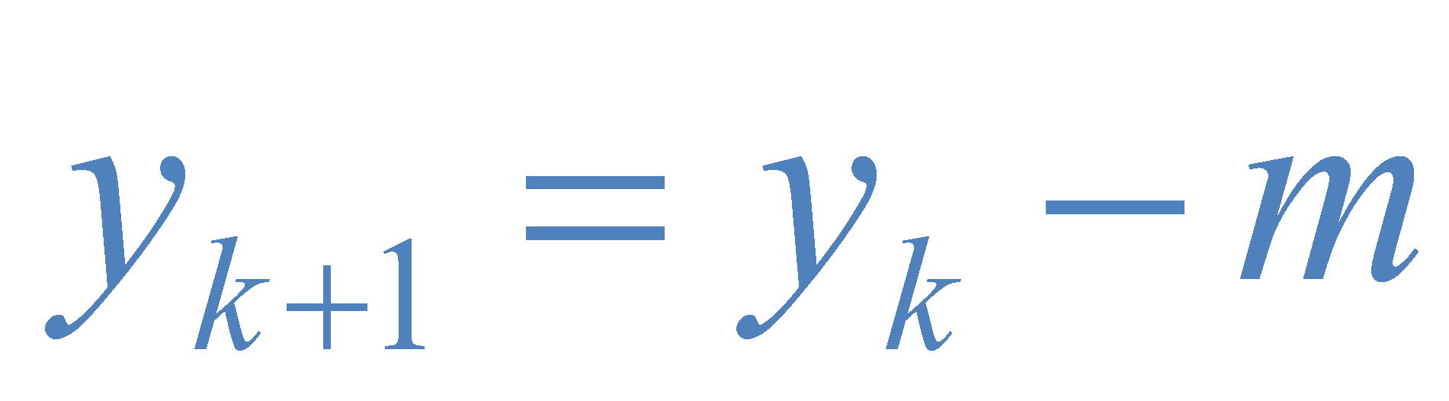
The DDA Algorithm cont..
Digital Differential Analyzer
0 < Slope <= 1
Unit x interval = 1
Slope > 1
Unit y interval = 1
-1 <= Slope < 0
Unit x interval = -1
y1
y2
x1
x2

Slide 8
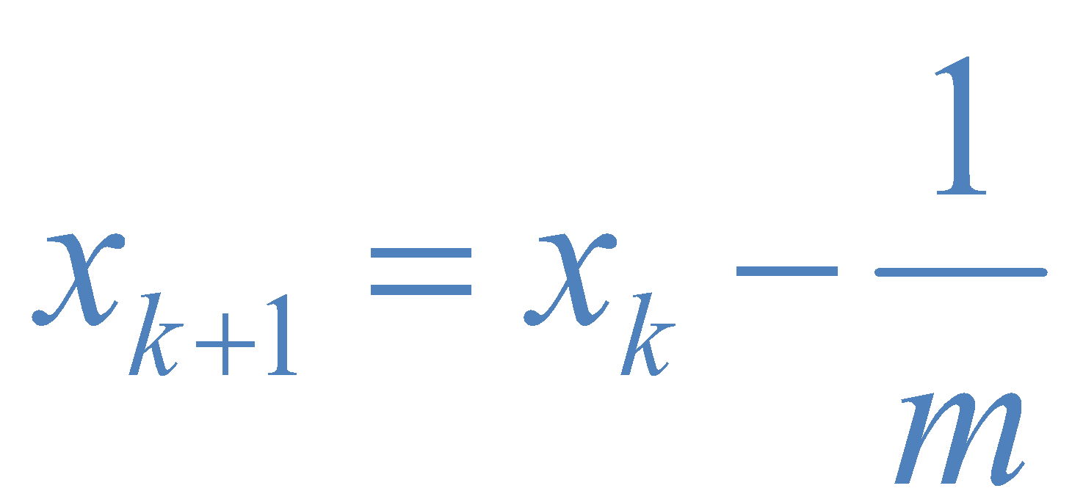
The DDA Algorithm cont..
Digital Differential Analyzer
0 < Slope <= 1
Unit x interval = 1
Slope > 1
Unit y interval = 1
-1 <= Slope < 0
Unit x interval = -1
Slope < -1
Unit y interval = -1
y1
y2
x1
x2

Slide 9
The DDA Algorithm cont..
DDA ALGORITHM
1. START
2. Get the values of the starting and ending co-ordinates i.e. ,(xa,ya) and (xb,yb).
3. Find the value of slope m
m=dy/dx=((yb-ya)/(xb-xa))
4. If ImI ≤ 1 then Δx=1,Δy=mΔx
xk+1=xk+1,yk+1=yk+m
5. If ImI ≥ 1 then Δy=1,Δx=Δy/m
xk+1=xk+1/m,yk+1=yk+1
6. STOP

Slide 10
The DDA Algorithm cont..
Desired line
(x_{i}+1,round(y_{i}+m))
(x_{i},y_{i})
(x_{i}+1,y_{i}+m)
(x_{i},round(y_{i}))

Slide 11
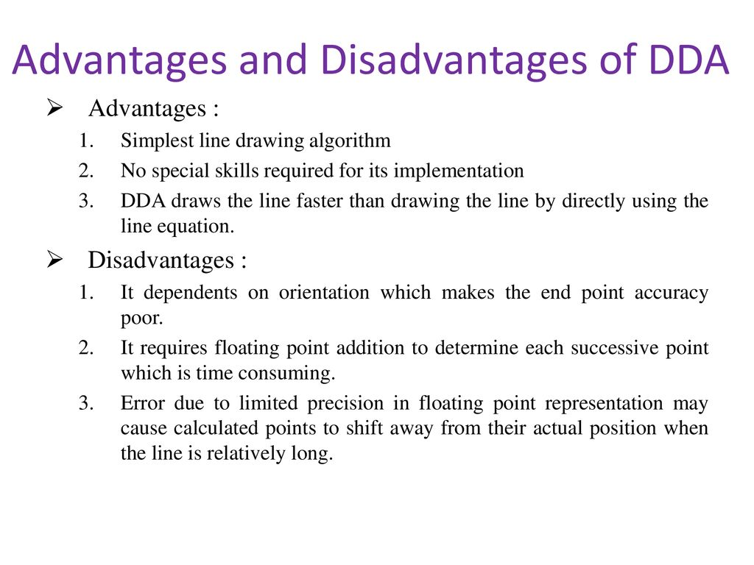

Slide 12
DDA Pseudo-code
// assume that slope is gentle
DDA(float x0, float x1, float y0, float y1)
{ float x, y;
float xinc, yinc; int numsteps;
numsteps = Round(x1) – Round(x0);
xinc = (x1 – x0) / numsteps;
yinc = (y1 – y0) / numsteps; x = x0;
y = y0; putpixel(Round(x),Round(y));
for (int i=0; i<numsteps; i++) { x += xinc;
y += yinc; putpixel(Round(x),Round(y));
}
}

Slide 13
Experiment – 3
Digital Differential Analyzer Algorithm
Digital differential analyzer (DDA) is used for linear interpolation of variables over an interval between given start, end points and for rasterization of lines, triangles and polygons. Using DDA Algorithm, Write a C-Program to draw a line segment between two given points?
Aim: To implement DDA Algorithm for drawing a line segment between two given end points A (x1, y1) and B(x2, y2).
Algorithm:
Start.
Declare variables x,y,x1,y1,x2,y2,k,dx,dy,s,xi,yi and also declare gdriver=DETECT, mode.
Initialize the graphic mode with the path location in TurboC3 folder.
Input the two line end-points and store the left end-points in (x1,y1).
Load (x1, y1) into the frame buffer; that is, plot the first point. put x=x1,y=y1.
Calculate dx=x2-x1 and dy=y2-y1.
If abs (dx) > abs (dy), do s=abs(dx).
Otherwise s= abs(dy).
Then xi=dx/s and yi=dy/s.
Start from k=0 and continuing till k<s,the points will be
x=x+xi.
Y=y+yi.
Plot pixels using putpixel at points (x,y) in specified colour.
Close Graph and stop.

Slide 14
Procedure-
Given-
Starting coordinates = (X₀, Y₀)
Ending coordinates = (X_{n}, Y_{n})
The points generation using DDA Algorithm involves the following steps-
Step-01:
Calculate ΔX, ΔY and M from the given input.
These parameters are calculated as-
ΔX = X_{n} – X₀
ΔY =Y_{n} – Y₀
M = ΔY / ΔX

Slide 15
Step-02:
Find the number of steps or points in between the starting and ending coordinates.
if (absolute (ΔX) > absolute (ΔY))
Steps = absolute (ΔX);
else
Steps = absolute (ΔY);
Step-03:
Suppose the current point is (X_{p}, Y_{p}) and the next point is (X_{p+1}, Y_{p+1}).
Find the next point by following the below three cases-

Slide 16
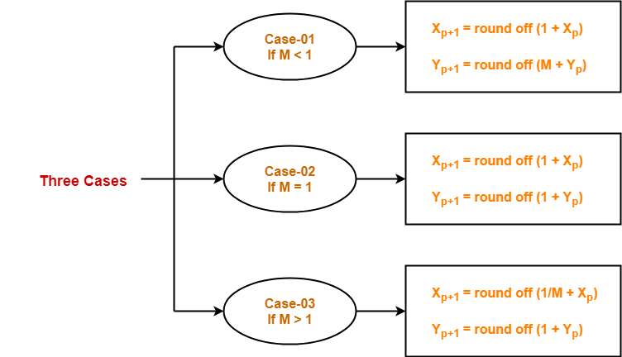
Step-04:
Keep repeating Step-03 until the end point is reached or the number of generated new points (including the starting and ending points) equals to the steps count.

Slide 17
DDA Example
•
Suppose we want to draw a line starting at pixel (2,3) and
numsteps = 12 – 2 = 10 xinc = 10/10 = 1.0
yinc = 5/10 = 0.5
X1-X0= 10
Y1- y0= 5
ending at pixel (12,8).
// assume that slope is gentle M<=1 DDA(float x0, float x1, float y0, float y1)
{
float x, y;
float xinc, yinc; int numsteps;
numsteps = Round(x1) – Round(x0); xinc = (x1 – x0) / numsteps;
yinc = (y1 – y0) / numsteps; x = x0;
y = y0;
putpixel(Round(x),Round(y));
for (int i=0; i<numsteps; i++) { x += xinc;
y += yinc; putpixel(Round(x),Round(y));
}}
Iteration | x | y | Round(x) | Round(y)
0 | 2 | 3 | 2 | 3
1 | 3 | 3.5 | 3 | 4
2 | 4 | 4 | 4 | 4
3 | 5 | 4.5 | 5 | 5
4 | 6 | 5 | 6 | 5
5 | 7 | 5.5 | 7 | 6
6 | 8 | 6 | 8 | 6
7 | 9 | 6.5 | 9 | 7
8 | 10 | 7 | 10 | 7
9 | 11 | 7.5 | 11 | 8
10 | 12 | 8 | 12 | 8

Slide 18

DDA Algorithm (continued)
Y_inc
X_inc
This DDA algorithm suffers from two reasons.
▪
Floating point calculations and rounding operations are expensive and time consuming.
Due to limited precision and Rounding operations calculated points will not be displayed at its original point.
•

Slide 19
Question: Draw a line from P(1,1) to Q(5,9) using DDA algorithm.
Solution: P(1,1) => x1 = 1, y1= 1 Q(5,9) => x2 = 5, y2 = 9
Now lets calculate the difference: dx = x2 — x1 = 5 –1 = 4 dy = y2 — y1 = 9 -1 = 8
Now lets calculate total number of points to plot: no Of Points ToPlot = max(abs(dx), abs(dy)) = max(|4|,|8|) = 8
Now, lets discuss why we go for a max here, because we want to draw line as accurate as possible and accuracy can be given by more no of points.
Now lets calculate increment for both the coordinates. xInc = dx/no Of Points To Plot = 4/8 = 0.5 yInc = dy/ no Of Points ToPlot = 8/8 = 1

Slide 20
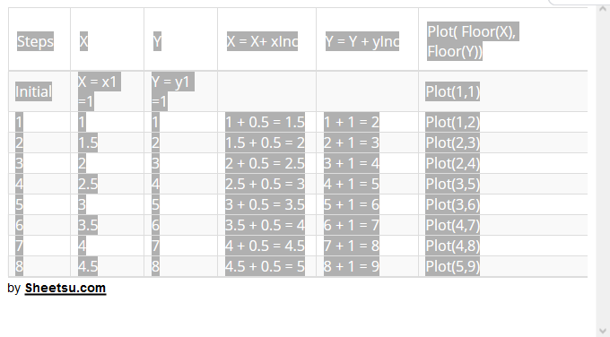
Now, list all the points to be plotted:

Slide 21
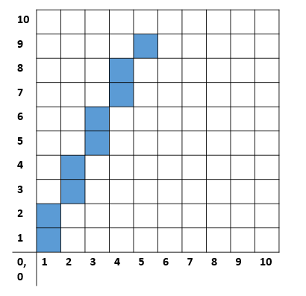
PLOT OF GRAPH

Slide 22
Questions
Q-1Write the full form of DDA?
Q-2 Why DDA is called Digital Differential Analyser?
Q-2What is the difference between DDA algorithm and Bresenham’s Algorithm ?
Q-3. Give disadvantages of DDA algorithm?
Q-4. Give disadvantages of DDA algorithm?

